Slide 1

The Formulas of Yield

Slide 2
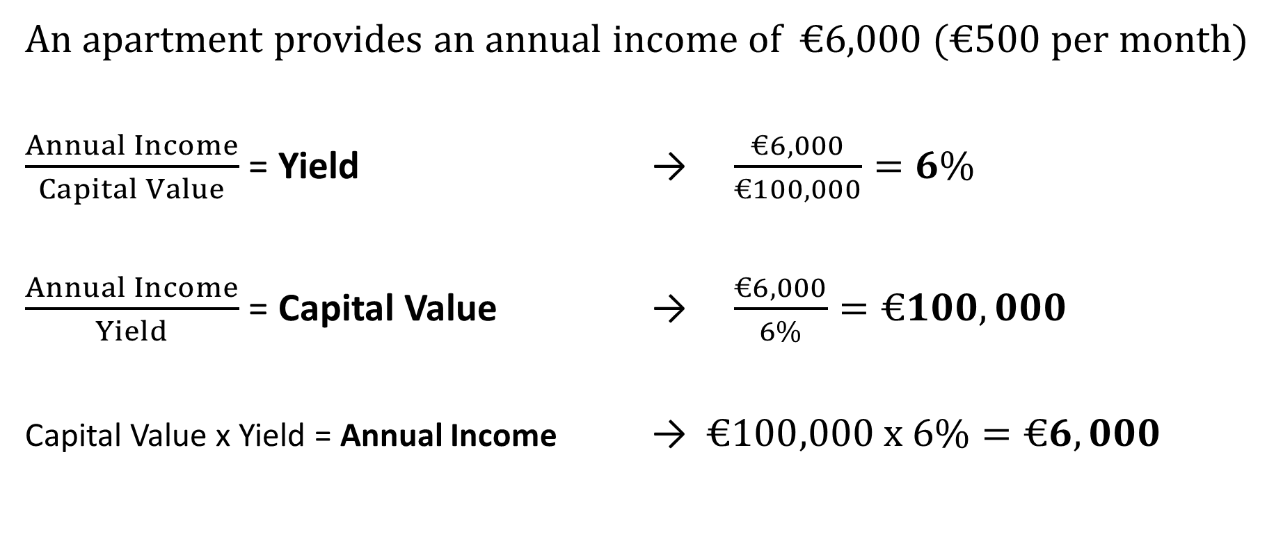
The Formulas of Yield
An apartment provides an annual income of €6,000 (€500 per month)
$\frac{Annual Income}{Capital Value}$ = Yield → $\frac{€6,000}{€100,000}=6\%$
$\frac{Annual Income}{Yield}$ = Capital Value → $\frac{€6,000}{6\%}=€100,000$
Capital Value x Yield = Annual Income → $€100,000 x 6\%=€6,000$

Slide 3
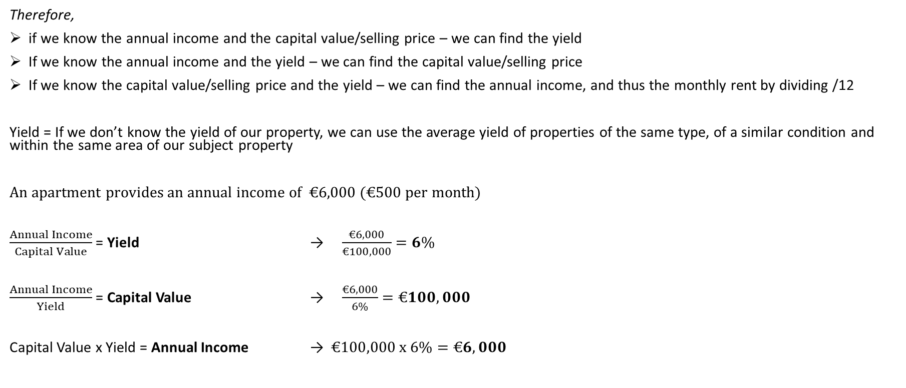
The Formulas of Yield
Therefore,
if we know the annual income and the capital value/selling price – we can find the yield
If we know the annual income and the yield – we can find the capital value/selling price
If we know the capital value/selling price and the yield – we can find the annual income, and thus the monthly rent by dividing /12
Yield = If we don’t know the yield of our property, we can use the average yield of properties of the same type, of a similar condition and within the same area of our subject property
An apartment provides an annual income of €6,000 (€500 per month)
$\frac{Annual Income}{Capital Value}$ = Yield → $\frac{€6,000}{€100,000}=6\%$
$\frac{Annual Income}{Yield}$ = Capital Value → $\frac{€6,000}{6\%}=€100,000$
Capital Value x Yield = Annual Income → $€100,000 x 6\%=€6,000$

